Slide 1

COMPANY
PROFILE

Slide 2

Table of contents
Who We Are
Our Vision and Mission
Our Service Offerings
Why Snapnet
Our Clientele
Our Partners
Contact Us

Slide 3

Who We Are
Snapnet Limited is an ICT consulting firm with strategic focus on helping organizations drive digital transformation through the development of industry specific solutions, Business Process Automation, Data Analytics and Cloud-based Infrastructure Solutions with offices in Lagos and Abuja.
We employ our high standards, first class innovation, and top quality personnel to deliver Business and Information Technology solutions that drive the operations of organizations for growth and effectiveness.

Slide 4

Our Vision and Mission
Vision
Mission
Our mission is to connect organizations to premium IT solutions that meet their specific needs.
Our aim is to innovatively transform organizations with adept business solutions in the IT space.
Core Values: (CITEE)
Community
Integrity
Tenacity
Excellence
Efficacy

Slide 5






Our Service Offering
Business Process Automation & ERP
Managed Service Providers
CORE
OFFERINGS
Security Solutions
Data Analytics & AI
Training & Support

Slide 6
Managed Service Providers
To have the competitive edge, businesses have to be technologically advanced. However, managing more and more complex IT systems becomes a challenge that’s why we offer professional managed services on a remote basis to take care of our customers’ IT infrastructure.
CLOUD INFRASTRUCTURE SOLUTIONS
Achieve increased flexibility, and efficiency at a reduced cost with world class Cloud based infrastructure and Solutions.
DIGITAL TRANSFORMATION
Empower your employees, engage your customers, transform your products and optimize your operation with our range of solutions.
HARDWARE PROCUREMENT
We provide leading IT hardware products (Laptops, Desktops, Routers, IT Accessories, etc.) from top manufacturers at the best rates.
SOFTWARE DEVELOPMENT
Our cutting-edge software development team have built bespoke solutions to improve efficiency, productivity, insights and profit.
PROJECT MANAGEMENT
From initiating, planning, executing, controlling, to closing projects, our team can manage your projects to achieve specific goals and meet specific success criteria at the specified time.
CONSULTING
Trying to solve all of your IT challenges internally can become a major distraction. As one of the top IT consulting firms, we empowers organizations on how best to use their IT in achieving their business objectives.
6

Slide 7
Data Analytics & AI
Data is everything! Make better business decisions, challenge your assumptions by turning information into insight with our latest cloud, big data and predictive analytics solutions.
DATA MODELING/WAREHOUSING
Our data scientists can create in-depth analysis of data objects and their relationships to other data objects in your company’s database.
ENTERPRISE REPORTING
Transform your company's data into rich visuals so you can focus on what matters to you. Stay in the know, spot trends as they happen, and push your business further.
PREDICTIVE ANALYTICS
Go beyond learning what happened and why it happened, to discovering insights about the future of your business.
MACHINE LEARNING
Use data analysis to take your business to a whole new level. With machine learning, extracts meaningful insights from raw data to quickly solve complex, data-rich business problems
CHATBOT
Leverage on an assistant that communicates with you through text messages; a virtual companion that integrates into websites, applications or instant messengers and helps you get closer to customers.
7

Slide 8

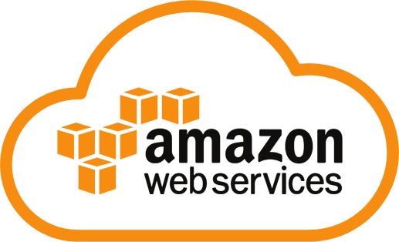

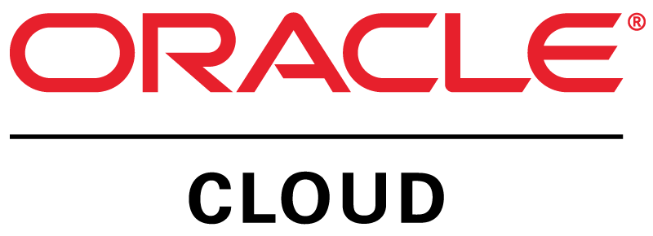
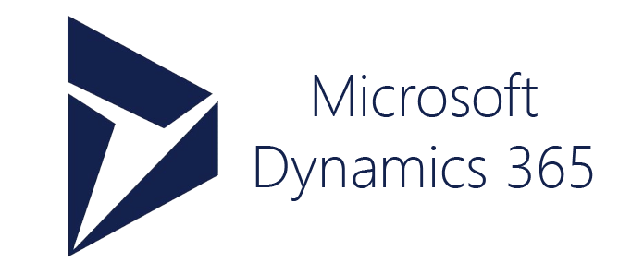

Cloud Solutions
Achieve increased flexibility, and efficiency at a reduced cost with Cloud based infrastructure and Solutions.
Microsoft Azure is an open, flexible, enterprise-grade cloud computing platform. Move faster, do more, and save money with IaaS + PaaS + SaaS.
Oracle Cloud delivers the broadest selection of enterprise-grade cloud computing solutions, including SaaS, PaaS, and IaaS.
Whether you're looking for compute power, database storage, content delivery, or other functionality, AWS can help you build sophisticated applications with increased flexibility, scalability and reliability
Unify CRM and ERP capabilities and break down data silos with Dynamics 365—modern, intelligent cloud applications that help move your business forward.
Transform your business with Google Cloud. Build, innovate, and scale with Google Cloud Platform.
8

Slide 9
Business Process Automation & ERP
Improve performance, enhance productivity and drive growth initiatives through automation of your business processes.
POWER APPS
Easily build the business apps you need and extend or customize the apps you already use that easily connects to data.
MICROSOFT AUTOMATE
Work less and do more by including powerful workflow automation directly in your apps with a no-code approach that connects to hundreds of popular apps and services.
BUSINESS PROCESS OPTMIZATION
We provide expert techniques to help organizations improve their efficiency by improving their business processes.
MICROSOFT SHAREPOINT
Our SharePoint deployment makes all business tasks much easier as well as enhance productivity and ROI exponentially.
DYNAMICS 365
Integrate business processes and allow quick decision making and customer engagement in real-time backed by adequate data—from marketing, sales, service, operations, to finance.
NETSUITE ERP
Accelerate your business performance using the world’s most deployed cloud ERP solution. From advanced financials to supply chain management to billing and beyond.
9
9

Slide 10






Microsoft Dynamics 365 Business Central
Intelligence
Data
Intelligent business applications in the cloud
Project management
Financial management
Operations management
Modern
Unified
Intelligent
Adaptable
Transformed experiences across, mobile, social, mixed reality, and modular applications
Flexible, scalable
Trusted Microsoft cloud and security
Rich, global ecosystem of partners
Business Central
Unified and intelligent data and processes
Rapid deployment, onboarding, and quicker time to value
Recognized as an industry leader
Full NAV functionality
Continued feature investments
Sales & service management
Reporting & analytics
Supply chain management
Power platform
Power BI
Flow
PowerApps
Notes:
Dynamics 365 Business Central is Microsoft’s next generation of intelligent business applications in the cloud.
It not only includes accounting and financial management capabilities, but also sales and service, project management, supply chain, inventory and operations management.
What makes Dynamics 365 Business Central unique is that it harnesses the power of One Microsoft.
Brings together the two worlds of business process and personal productivity. We surface familiar tools like Excel and Word within the context of business processes, significantly increasing productivity and decreasing context switching.
Power BI and Cortana Intelligence are natively embedded into Dynamics 365 Business Central business applications for predictive insights, prescriptive advice and actionable next steps. Additionally, Azure IoT brings device data to enable preemptive action in business functions like field service.
Businesses can also adapt and innovate in real-time with a common data model and an extensible business application platform, including PowerApps, Flow and Power BI Embedded.
We have also introduced Microsoft AppSource so business users to easily find and evaluate line of business SaaS applications from Microsoft and our partners, across Dynamics 365, Office 365, Cortana Intelligence and the Azure platform.

Slide 11
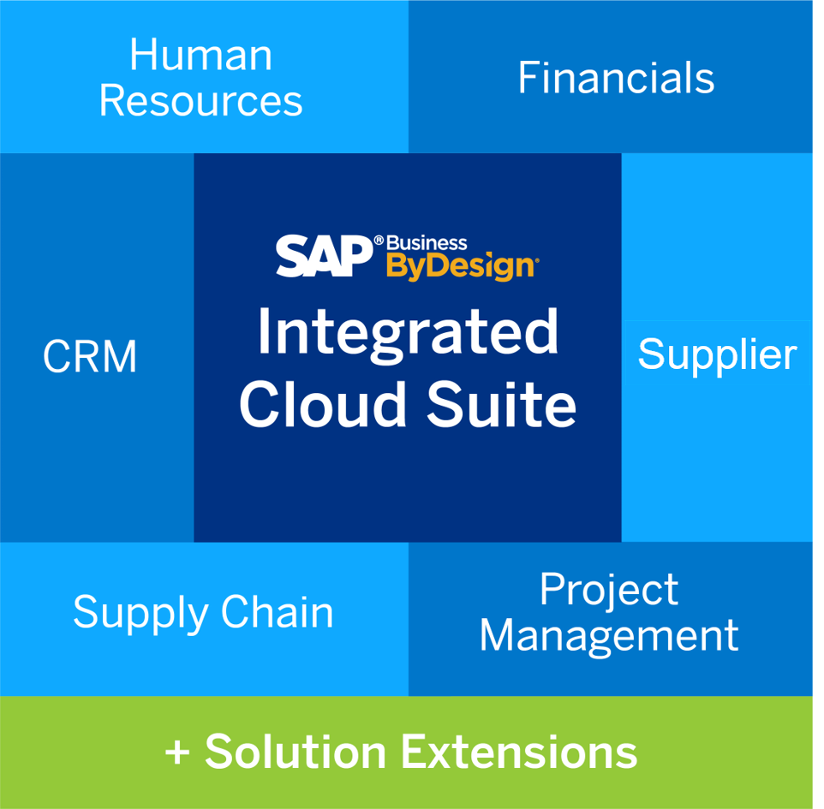
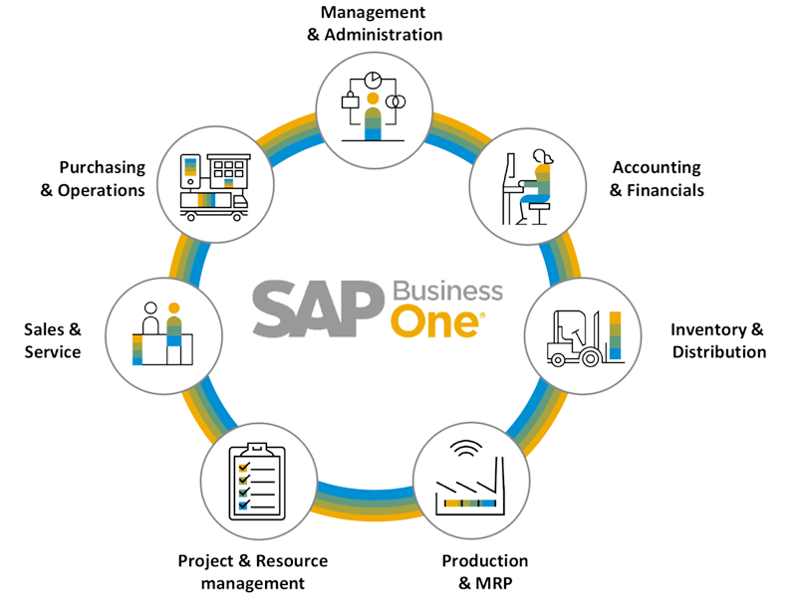
Business Process Automation & ERP
11
11

Slide 12
Security Solutions
To secure today’s distributed networks, organizations must develop defense-in-depth strategies that combine network-enforced security technologies with best practices.
With cyber attacks on the rise, we provide organizations with powerful IT weapons for fighting all kinds of cyberthreats.
IDENTITY & ACCESS MANAGEMENT
UNIFIED THREAT MANAGEMENT
ENDPOINT PROTECTION &
DATA LOSS PREVENTION
ENCRYPTION – DATABASES, APPLICATION & FILES
CLOUD SECURITY
VULNERABILITY & PENETRATION TESTING
PERIMETER SECURITY
12

Slide 13
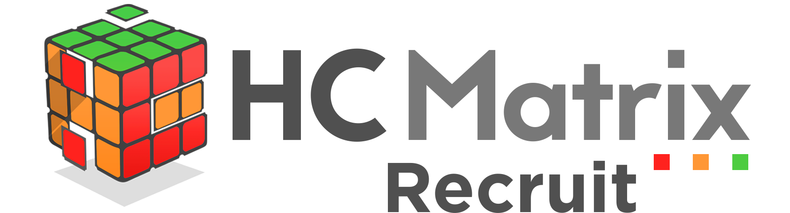
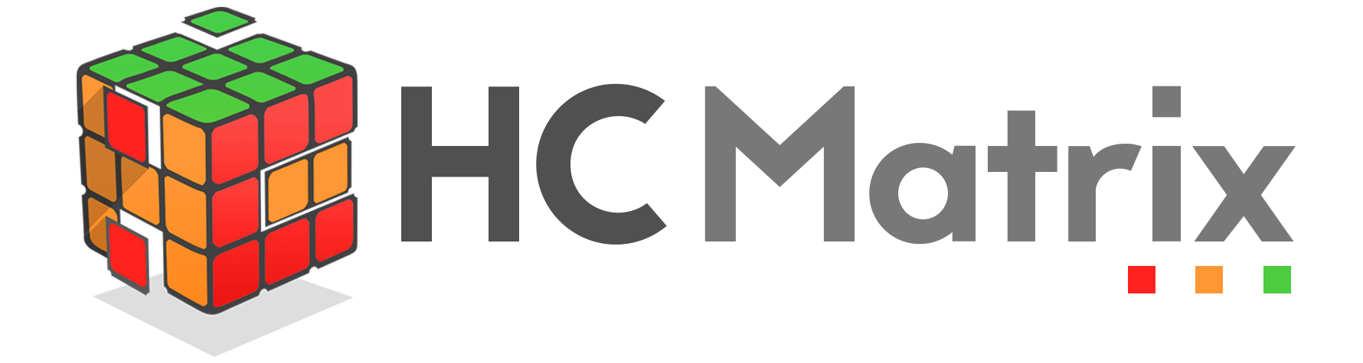

Our Products
It is an integrated, end-to-end cloud-based HCM solution that is amazingly easy to use, affordable, easy to deploy and ideal for all business type.
Key Features
Payroll & Finance
Absence Management
Goal & Performance Management
Training & Development
Reports & Analytics and many more.
It is an inventory management and P.O.S system that combines the use of desktop software, barcode scanners, barcode printers, and mobile devices to ensure smooth-running and management of inventory.
Key Features
Sales & Product Tracker
Executive Dashboard
Product Expiration Tracker
Warehouse Manager
People Management and many more.
It is a recruitment solution that makes the hiring process not only more measured, but more defined and transparent with a real emphasis on the overall quality of hire and the hiring process.
Key Features
CBT/E-interviews
Talent Pool
Applicant Tracker
Duplication Detection
Job Posting and many more.
13

Slide 14
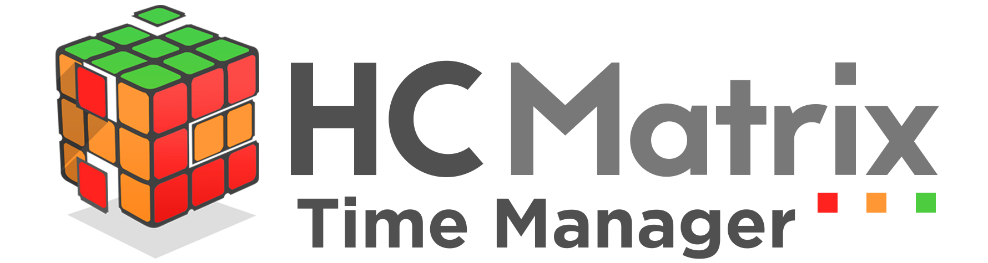
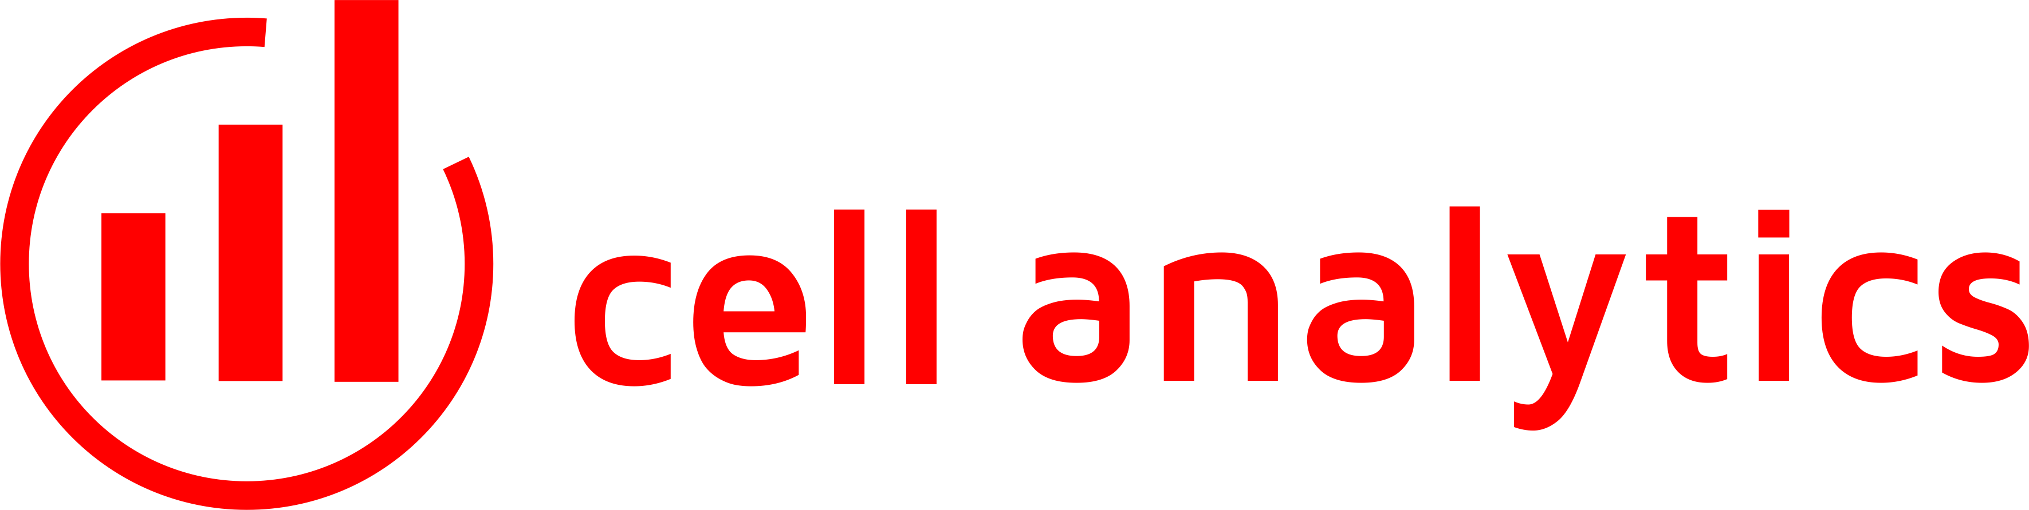
Our Products
It is an cloud-based time & attendance solution that empowers users with informed real-time decision making capabilities. Control labor cost & increase quality and efficiency.
Key Features
Link Attendance and Payroll
Online Time Sheets
Location based clock in/out
Overtime Management
Employee Self-service
Time Card Notification
Report & Analytics and many more.
It is a Management Information System (MIS) that provides real time financial analytics for financial institutions. View a whole set of predefined metrics and KPIs, allowing end-users to easily identify issues, emerging trends, monitor key stock levels and take intuitive and faster actions.
Key Features
Totally scalable & secure
Entirely Cloud based
Interactive Dashboard
Customizable metrics & KPIs
Real time information
Accessible collaboration anywhere and many more.
14

Slide 15

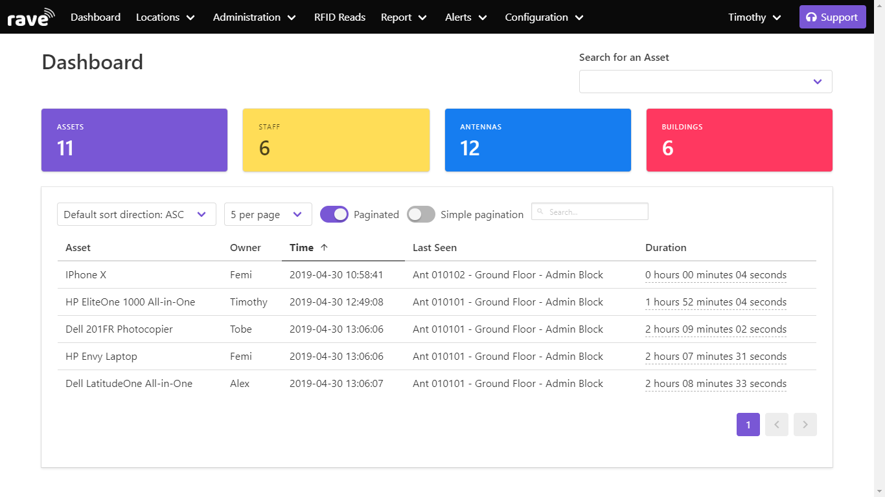
Our Products
Rave Asset Tracking System is an integrated tracking solution that can monitor and track asset locations, giving you the ability to clearly see where they’re located or who they’re being assigned to—eliminating the guesswork, costly losses, and wasting of valuable time.
Key Features
Real-time location tracking
Asset log & history
Multiple location tracking
Highly scalable
Easy integration with inventory management systems
Alert and Reporting system and many more.
15

Slide 16


Our Products
Meet AjeBota, the stylish, intelligent and humorous chatbot that can make your customers/employees happier every day.
AjeBota can make sales, answer multiple questions and automate repetitive tasks.
Our AI & Machine Learning technology lets us to continually improve the bot by collecting and analyzing historical chat data.
Key Features
Real-time Interactions
Rich Messaging
Tasks Automation
Machine Learning
3rd Party Integrations
Custom Reporting system and many more.
16

Slide 17


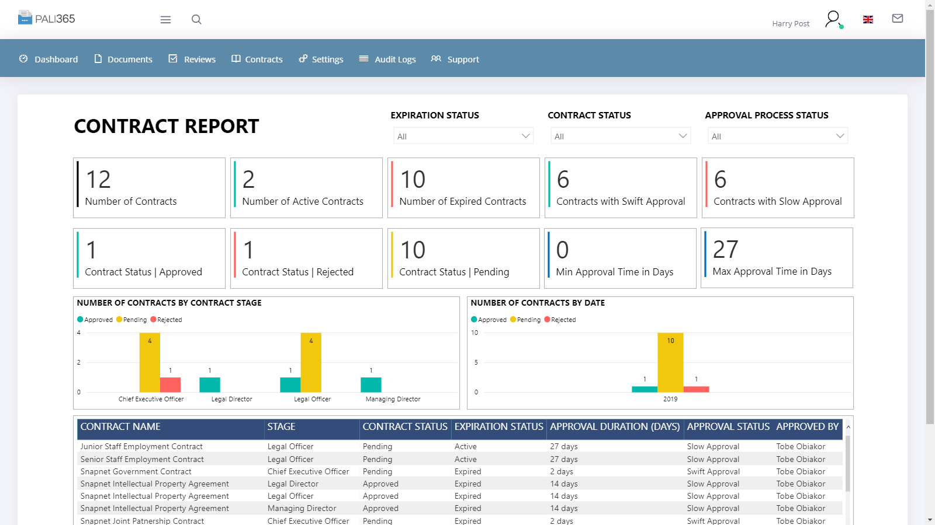
Our Products
PaliPro is a contract management system that allows organizations to easily create, approve, track and manage all contracts during the contract life cycle.
Key Features
Microsoft Word rich-text interface
Clause management
3rd Party reviewing & real-time collaboration
Internal & External Workflow Management
Version control & history
Built-in e-signature tool
Central contract repository
Rich dashboard with advanced analytics
Custom alerts & notification and many more.
17

Slide 18

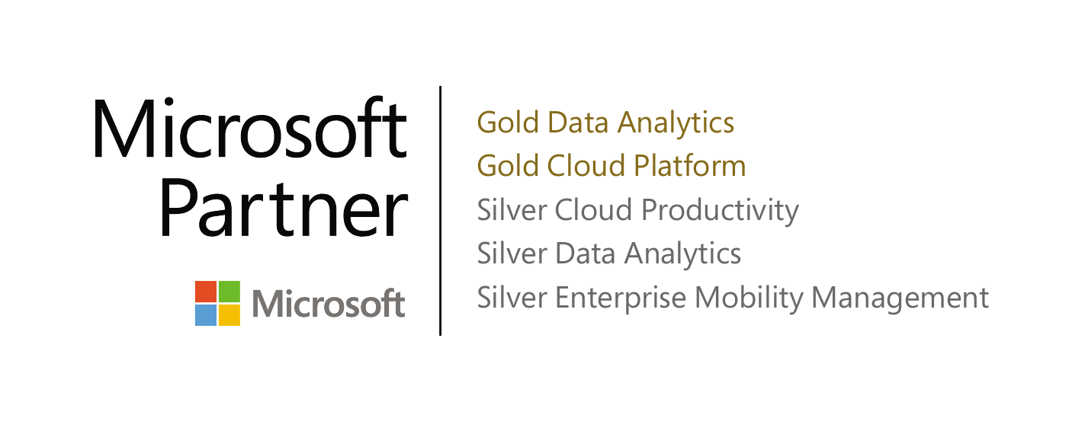
Why Snapnet
Top Microsoft Partner – Tier 1 Cloud Solutions Provider
Data Analytics and Business Intelligence Experts
Strategic Partnerships and Alliance with World-Class Organizations
Outstanding Portfolio and Customer Success Stories
Customer Centric, Providing Effective Organizational Support
Offers the best flexible and affordable rates in the industry without sacrificing quality.

Slide 19


















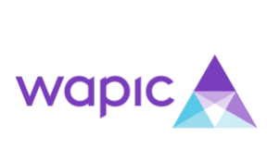




Our Clientele
19

Slide 20










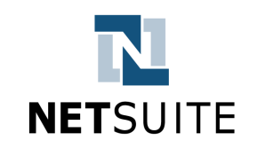


Our Partners
We are a strategic partners to leading global players to proffer solutions that caters for the needs of business users, developers, IT professionals, and everyone in the IT chain.
20

Slide 21





Contact Us
SNAPNET LIMITED
…providing solutions in a snap
LAGOS (HEAD OFFICE)
Plot 1b Abayomi Shonuga Crescent,
Off Dele Adedeji Street,
Lekki Phase1, Lagos, Nigeria.
info@snapnet.com.ng |+2349090004652
ABUJA
4th Floor Phase II, Rivers House,
83 Ralph Shodeinde Street,
CBD, Abuja, Nigeria.
info@snapnet.com.ng | +2349090004652
www.snapnet.com.ng
Snapnet Nigeria
Snapnet Nigeria
Snapnet_Nigeria
Snapnet Nigeria

